Slide 1
ES 200:Autumn 2020
Environmental Studies : Science and Engineering
Module C: Solid Waste Management
Prof. Tabish Nawaz (Module C)
(tnawaz@iitb.ac.in)
Environmental Science and Engineering Dept.,
IIT Bombay
* Instructor In-Charge
(vsethi@iitb.ac.in)

Slide 2
Module C
Solid Waste Management
Lecture-5 Topics
MSW Processing Techniques
Biochemical Methods

Slide 3

Biochemical Processes for the recovery of conversion products from MSW
Process | Conversion product | Preprocessing
Aerobic conversion | Compost (soil conditioner) | Separation of organic fraction, particle size reduction
Alkaline hydrolysis | Organic acids | Separation of organic fraction, particle size reduction
Anaerobic digestion (in landfill) | Methane | None, other than placement in containers
Anaerobic digestion | Methane | Separation of organic fraction, particle size reduction
Fermentation | Ethanol, single-cell protein | Separation of organic fraction, particle size reduction, acid or enzymatic hydrolysis to produce glucose

Slide 4
Composting (Aerobic Conversion)
If the organic materials (excluding plastics, rubber, and leather) are separated from MSW, and are subjected to bacterial decomposition, the end product remaining after dissimilatory and assimilatory bacterial activity is called compost or humus.
The entire process involving both separation and bacterial conversion of the organic solid wastes is known as composting.
Most composting operations involve 3 basic steps:
Preparation of the solid wastes
Receiving, sorting, separation, size reduction, moisture and nutrient addition
Decomposition of the solid wastes
Several techniques used to convert waste to humus
Product preparation and marketing
Fine grinding, blending with additives, granulation, bagging, storage
Notes:
Assimilatory bacteria – bacteria making their own cells from the nutrients in organic materials, hence consuming energy
Dissimilatory bacteria – bacteria decomposing the organic material, hence producing energy
Inoculants – bacteria or fungi that are bought from the market and added to the compost to speed up the process
Additives – (N-based) fertilizers, manure, etc. which act as food for bacteria
Activators – Enzymes which act as fertilizers

Slide 5
Composting (Aerobic Conversion)
Four process variables in composting process:
Organic matter: Includes plant materials and some animal manures.
Should include a mixture of
Brown organic material: Carbon-rich materials like, dead leaves, twigs, etc.
Green organic material: Nitrogen-rich materials like, lawn clippings, food scraps, manure, etc.
Brown materials supply carbon, while green materials supply nitrogen, moisture, oxygen, and bacteria.
2. Moisture content:
Important to support the composting process by microbes.
If the pile is too dry, materials will decompose very slowly.
If the pile is too wet, turn the pile and mix the materials or add dry, brown organic materials.
Notes:
Bulking agents – keep the system aerated - eg:- wood chips

Slide 6
Composting (Aerobic Conversion)
3. Oxygen:
Oxygen is needed to support the breakdown of plant material by bacteria.
To supply oxygen, the compost pile is turned, so that materials at the edges are brought to the center of the pile.
Turning the pile is important for complete composting and for controlling odor.
4. Particle Size:
Grinding, chipping, and shredding materials increases the surface area on which microorganisms can feed.
Smaller particles produce a more homogeneous compost mixture and improve pile insulation to help maintain optimum temperatures.
If the particles are too small, they might prevent air from flowing freely through the pile.

Slide 7
Composting (Aerobic Conversion)
Temperature and Microorganisms:
By supplying organic materials, water, and oxygen, the bacteria already present will break down the plant material into useful compost.
As the bacteria decompose the materials, they release heat, which is concentrated in the center of the pile.
In addition to bacteria, larger organisms including insects and earthworms are also active composters.
Microorganisms require a certain temperature range for optimal activity. If the temperature does not increase, anaerobic conditions (i.e., rotting) occur.
Controlling the four process variables can bring about the proper temperature.

Slide 8
Stages of Composting
Stage 1:
Typically only a couple of days long, during which mesophilic microorganisms (20 – 40ºC temperature), begin physically breaking down the biodegradable compounds.
Heat is a natural byproduct of this initial process and temperatures quickly rise to over 40ºC.
Stage 2:
Lasts from a few days to several months, where mesophilic microorganisms are replaced by thermophilic microorganisms (45 – 120ºC ).
The higher temperatures are more conducive to breaking down proteins, fats and complex carbohydrates.
Temperatures continue to rise and the compost pile can get so hot that it can eventually kill off all the helpful microorganisms.
Aeration and turning over the compost pile help control, as well as provide additional oxygen and new sources for the thermophilic microorganisms to break down.
Notes:
Beyond 65 deg Celsius, it is possible for helpful microorganisms to be killed off.

Slide 9
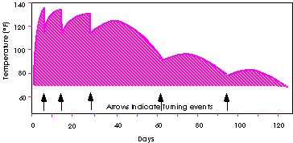
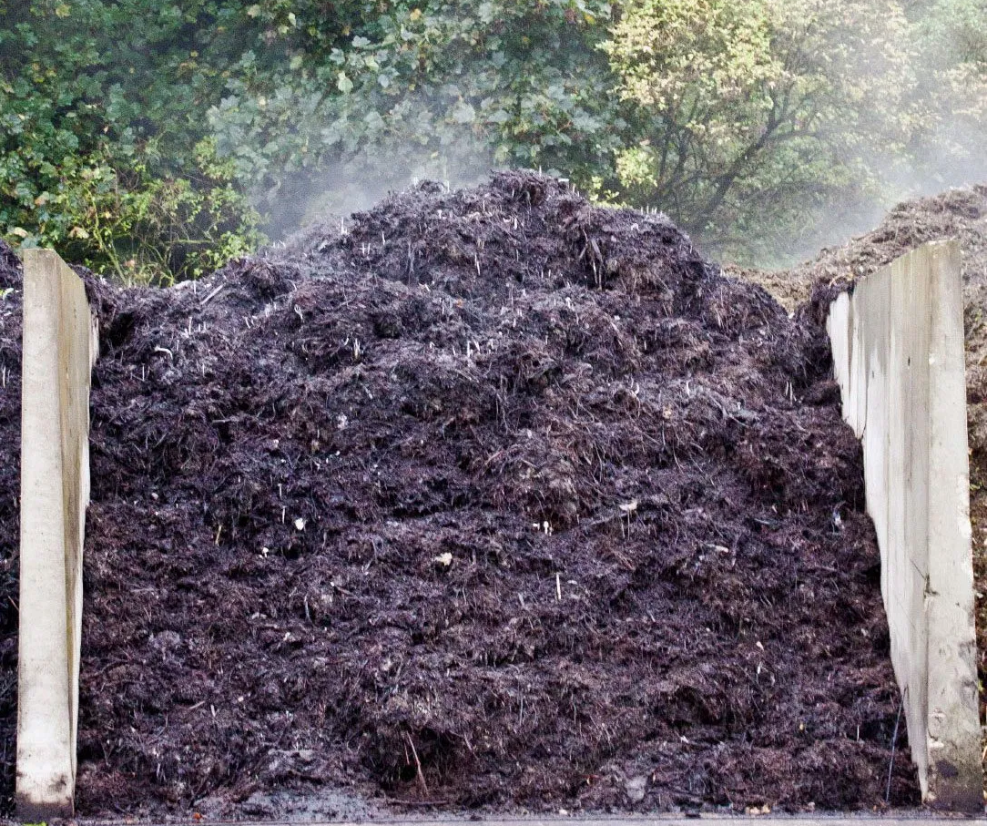
Stages of Composting
Stage 3:
Typically lasts for several months, begins when the thermophilic microorganisms use up the available supply of the compounds.
Temperatures begin to drop enough for mesophilic microorganisms to resume control of the compost pile and finish breaking down the remaining organic matter into usable humus.
About 80 to 90 percent of all microorganisms found in compost piles are bacteria.
Overheated Compost Piles
http://compost.css.cornell.edu/Factsheets/FS5.html
Notes:
Stage 3 – Curing/Naturation of remaining organic matter
Above 55 deg Celsius, most pathogenic bacteria will be killed. High temperatures can also cause spontaneous combustion which may lead to a fire. There are other organisms that decompose the compost pile such as mold, yeast and fungi.

Slide 10
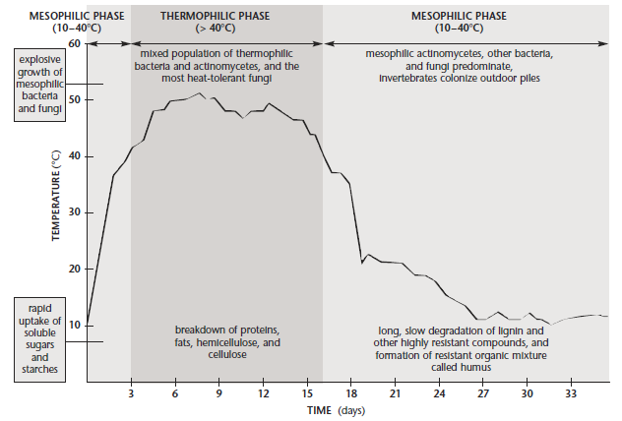
3 Stages of Composting

Slide 11
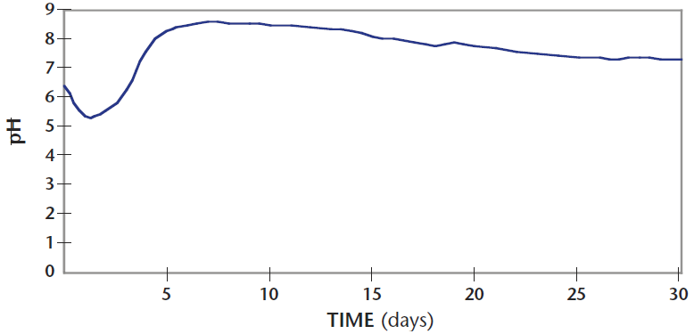
Typical Change in pH during Composting
Composting in the Classroom: Scientific Inquiry For High School Students. N.M. Trautmann., M.E. Krasny., Center For The Environment, Department Of Natural Resources, Cornell University
Notes:
Acidogenesis → Generation of organic acids → Initial drop in pH → Growth of fungi → Decomposition of lignin and cellulose Organic acids decompose with time + Decomposition of proteins and other nitrogen-rich organic sources to produce ammonia → Increase in pH
NH3 is lost to the atmosphere or absorbed by microorganisms → pH returns to neutral (6-8)
In anaerobic conditions, pH drops to about 4.5 and can be recovered by aeration
Lime/other alkaline matter should not be added on the initial dip in pH since that will add excess ammonia to compost, which in turn, being a toxic gas, will harm microorganisms and will have a bad odour.

Slide 12

What to Compost and What not to Compost
Can be composted:
Leaves
Manures (herbivores)
Lawn clippings
Vegetable or fruit wastes
Coffee grounds
Shredded newspaper
White, unglazed office paper
Trimmed plant materials
Shredded stems and twigs
https://www.avasflowers.net/blog/learning-to-compost/
Not to be composted:
Meat or dairy scraps
Manures from carnivores (cat, dog, etc.)
Glazed, color printed magazine paper
Plastic
Diseased plants or plants with herbicides applied
Latex gloves, fabric, metal, pharma products, detergents, Styrofoam

Slide 13
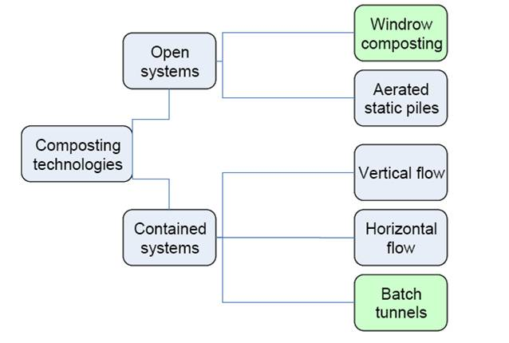
Types of Composting Systems
http://userspecial.com/windrow-composting-process/
https://www.epa.gov/sustainable-management-food/types-composting-and-understanding-process

Slide 14
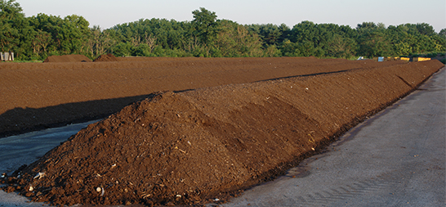
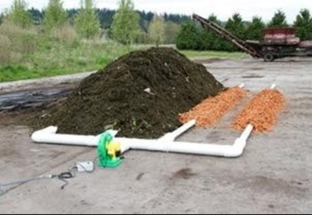
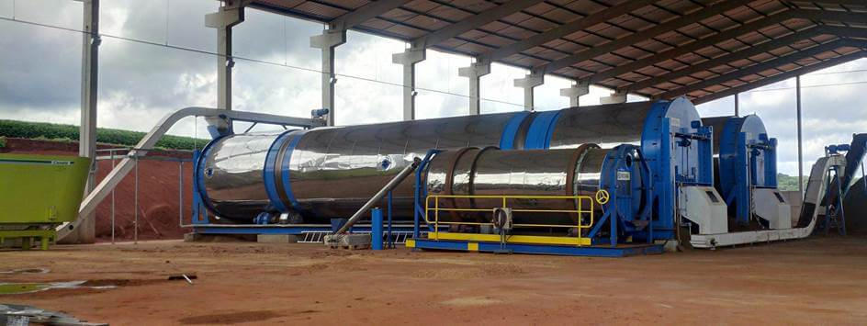
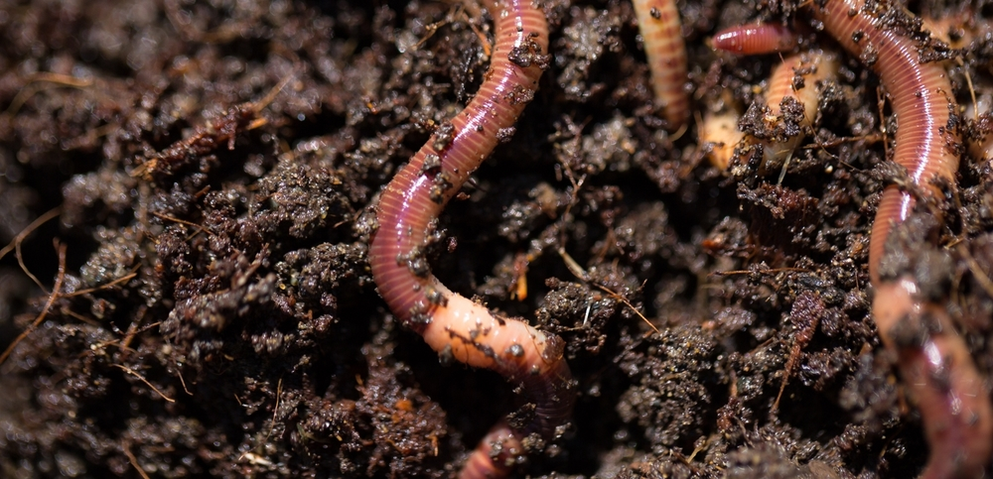
Types of Composting Process
Windrow Composting Process
Static (active) composting
Rotary drum composter
Vermicomposting
http://userspecial.com/composting-types-of-composting-process/

Slide 15
Design Consideration for Aerobic Composting Process
Process variable | Description
Particle Size | For optimum results, size of solid wastes should be between 25 and 75 mm
Seeding and mixing | Composting time can be reduced by seeding with partially decomposed solid wastes to the extent, 1 to 5% by weight. Sewage sludge can also be added to prepared solid wastes. Where sludge is added, the final moisture content is the controlling variable.
Mixing/turning | To prevent drying, caking and air channeling, material in the process of being composted should be mixed or turned on a regular schedule as required. Frequency of mixing or turning depends on type of compositing operation.
Air requirements | Air with at least 50% of the initial oxygen concentration remaining should reach all parts of the composting material for optimum results, especially in mechanical systems

Slide 16
Design Consideration for Aerobic Composting Process
Process variable | Description
Total oxygen requirements | Theoretical oxygen requirement can be estimated (equation in slide 8)
Moisture content | Should be between 50 – 60%, during the composting process.
Temperature | For best results temperature should be maintained between 50 – 55ºC for the first few days, and between 55 – 60ºC for the remainder of active composting period. If the temperature exceeds 66ºC, biological activity is impeded.
* C/N ratio | Initial C/N ratio (by mass) should be between 30 to 50. At lower ratios ammonia is released, and biological activity is impeded. At higher ratios, nitrogen may be the limiting nutrient, and decomposition occurs at a much slower rate, as less heat is generated due to the microorganisms not being able to grow and reproduce as readily, and therefore not able to break down the carbon

Slide 17
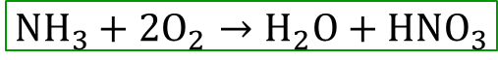
Design Consideration for Aerobic Composting Process
Process variable | Description
pH | pH should not be greater than 8.5 to minimize loss of nitrogen in the form of ammonia gas.
Control of pathogens | If properly conducted, it is possible to kill pathogens, weeds and seeds during composting. To do this, just for 24 hr., temperature should be maintained between 60 – 70ºC.
The amount of oxygen required for complete aerobic stabilization of MSW can be estimated as:
$$C_{a}H_{b}O_{c}N_{d}+{\left(\frac{4a+b−2c−3d}{4}\right)O}_{2}→aCO_{2}+\left(\frac{b−3d}{2}\right)H_{2}O+dNH_{3}$$
If the ammonia is to be oxidized to nitrate, the amount of oxygen required:
$$NH_{3}+{2O}_{2}→H_{2}O+HNO_{3}$$

Slide 18
Composting Methods in India
Indore Method (Aerobic)
Involves manual turning of piled up mass (MSW + manure/night soil) for decomposition under aerobic conditions.
Layers of vegetable wastes and night solid are alternatively piled in depths of about 7.5 to 10 cm each, and a total depth of 1.5 m in a trench; or above the ground to form a mound (windrow).
Windrows are generally 2.5 to 3 m wide at the base, and 50 m in length.
Manual turning done at small installations; mechanical devices like self-propelled overcab loaders at larger plants.
Moisture content maintained at 55ºC , and turning process takes 4-5 weeks.
Curing takes place for 2-8 weeks, total composting process takes 3-4 months to complete.
Notes:
Manual turning – using pitchforks – at smaller plants

Slide 19
Composting Methods in India
Bangalore Method (Anaerobic)
Involves anaerobic decomposition without any turning or handling of the mass, and it is cleaner than the Indore method.
Widely adopted by municipal authorities.
MSW and manure/night soil piled up in layers in an underground earthen trench (10 m x 1.5 m x 1.5 m).
This mass is covered up at its top by a layer of earth about 15 cm depth.
Within 2-3 days of burial biological action takes place and temperature raises to 75ºC subsequently.
Within 4-5 months, humus is formed, and the waste is stabilized.
Initial C/N ratio and moisture content are important process variables.
Notes:
Humus – brown-coloured odourless innocuous powdery mass – passed through 12.5 mm sieve to remove stones, broken glass, brick pieces, etc. and sold in market as fertilizer/manure

Slide 20
Importance of C/N ratio in Biochemical Processing
C/N ratio is one of the factors for the bacterial activity to continue, since bacteria use nitrogen for building their cell structure (as proteins) and carbon (as energy).
The anaerobic bacteria developing in digestion use up carbon about 30-50 times faster than they use nitrogen.
Hence, for proper development of anaerobic digestion, C/N ratio of the digestive material should be between 30 – 50 for optimum performance.
However, when C/N ratio is too high, nitrogen will be used up and carbon left over, thereby the digestion of organic matter incomplete.
If C/N ratio is too low, carbon will get exhausted and fermentation stops, leaving nitrogen in the digester, which combines with hydrogen to form ammonia (NH₃), which can inhibit growth of methane producing bacteria.

Slide 21
Anaerobic Digestion
Anaerobic digestion is the process for production of methane from solid wastes, in the absence of oxygen.
Basic steps involved for MSW digestion:
Preparation of the organic fraction of solid wastes
Receiving, sorting, separation, size reduction
Anaerobic digestion of wastes
Addition of moisture and nutrients,
blending, pH adjustment to about 6.7
heating of the slurry to between 55 – 60ºC
Anaerobic digestion in a reactor with continuous flow
Mixing of constituents over a period of 5 – 10 days
Capture, storage, and separation of gas components
Disposal of digested solids

Slide 22
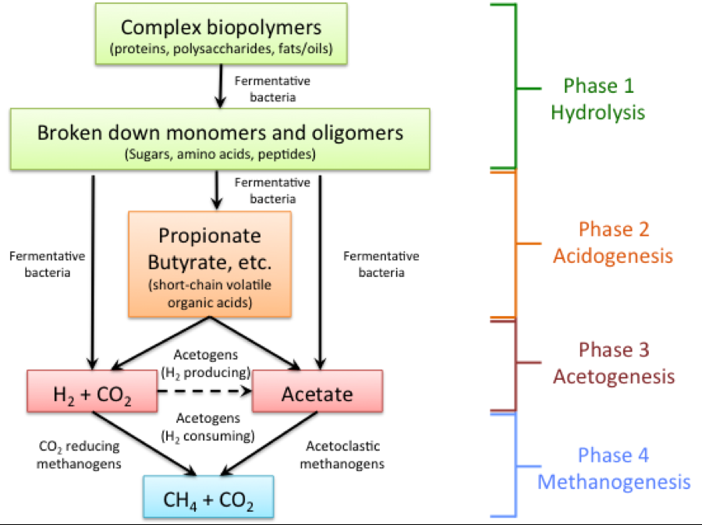
Carbon Flow in Anaerobic Digestion
https://www.e-education.psu.edu/egee439/node/727
Notes:
Methanogens – strictly anaerobic

Slide 23
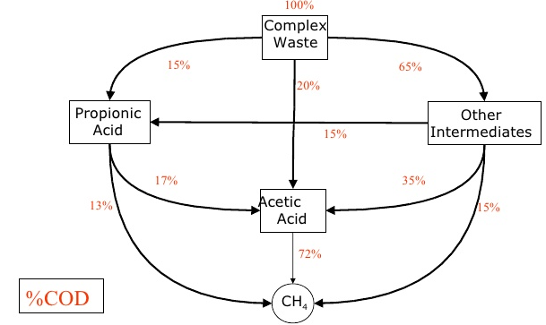
Chemical Pathways in Anaerobic Digestion
Notes:
Chemical Oxygen Demand = amount of oxygen required to completely oxidize all of the organic matter present in a sample of the mixture – indirect way to measure organic strength of a mixed sample

Slide 24
Design Consideration for Anaerobic Digestion Process
Process variable | Description
Particle Size | Wastes to be digested should be shredded to a size that will not interfere with the efficient functioning of pumping and mixing operations.
Mixing equipment | Mechanical mixing is recommended to avoid scum buildup and achieve optimum results
% of solid wastes mixed with sludge | Although amount of wastes varying from 50 – 90% have been used 60% is typical
Hydraulic and mean-cell residence time (θ_{h}=θ_{c}) | Washout time is in the range of 3 – 4 days. Use 7 – 10 days for design or base the design on pilot-plant studies.
Loading rate | Can vary significantly
Temperature | Between 55 – 60ºC
Destruction of volatile solid wastes | Varies from 60 – 80%
Total solids destroyed | Varies from 40 – 60% depending on inert fraction
Gas production | 0.5 – 0.75 m³/kg of volatile solids destroyed (CH₄ ~ 60%; CO₂ ~ 40%)

Slide 25
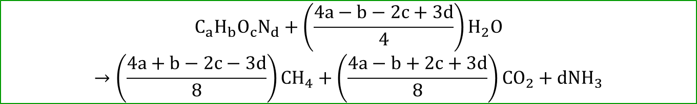
Design Consideration for Anaerobic Digestion Process
The theoretical amount of methane gas from anaerobic digestion of a waste with composition (C_{a}H_{b}O_{c}N_{d}) can be calculated as:
$$C_{a}H_{b}O_{c}N_{d}+{\left(\frac{4a−b−2c+3d}{4}\right)H}_{2}O→\left(\frac{4a+b−2c−3d}{8}\right)CH_{4}+\left(\frac{4a−b+2c+3d}{8}\right){CO}_{2}+dNH_{3}$$
In practice, a portion of the waste would be used for synthesis of cell tissue. The actual volume of gas would about 0.85 times the theoretical value.
Biogas is normally composed of 60-70% CH₄ and ~ 30% CO₂ and remaining 5% of nitrogen and other inert gases
(calorific value ~ 36,000 kJ/m³)

Slide 26
Summary Questions
Q1) Estimate the amount of air required to completely oxidize 1 tonne of solid waste having the chemical formula C₅₀H₁₀₀O₄₀N.
Q2) Explain why C/N ratio is an important parameter in biochemical processing of wastes?

